Slide 1



Data mining
An Assessment of Clustering Techniques with Mall Customer Segmentation Data
Will Hinton
College of Business, Engineering, and Technology (COBET)
National University
TIM-8131 v1: Data Mining
Professor Sebhatleab Gezehey
October 26 2025
Notes:
Hello Good-day! My name is Will Hinton from the College of Business, Engineering, and Technology at National University. Today I will present my research, titled.’ An Assessment of Clustering Techniques with Mall Customer Segmentation Data. This study examines Unsupervised Learning through six clustering techniques, evaluating each in terms of performance, scalability, robustness, and interpretability. We’ll compare the main ideas, advantages, disadvantages, and applications of each clustering method.

Slide 2
An Assessment of Clustering Techniques with Mall Customer Segmentation Data
Introduction
Methodology Overview
K-Means Clustering
K-Medoids (PAM)
Agglomerative Hierarchical Clustering
Density-Based Spatial Clustering of Apps with Noise (DBSCAN)
Gaussian Mixture Models (GMM)
Bayesian Clustering
Evaluation Metrics
Comparative Analysis
Key Insights, Conclusion & Reflection
References
Notes:
As per our table of contents, in this session, I will cover the Introduction, an overview of the methodology, the six clustering algorithms as applied to the Mall Customer Segmentation dataset. Including: 1. K‑Means clustering: partitions n observations into k clusters by assigning each observation to the cluster with the nearest mean (centroid) and minimizing the within‑cluster sum of squares .
K‑Medoids clustering: splits the data into k clusters and chooses as each cluster’s representative the object whose total dissimilarity to other cluster members is smallest (the medoid), a strategy known as Partitioning Around Medoids (PAM) .
Agglomerative hierarchical clustering: follows a bottom‑up procedure that starts with each data point as its own cluster and iteratively merges the two most similar clusters based on a distance metric and linkage criterion until a stopping condition is met .
DBSCAN: a density‑based, non‑parametric algorithm that groups together points in high‑density regions and labels points in sparse regions as noise or outliers .
Gaussian mixture models (GMM): assume data are generated from a mixture of a finite number of Gaussian distributions with unknown parameters, allowing soft (probabilistic) cluster assignments and capturing covariance structure .
Bayesian clustering (Bayesian GMM): uses variational Bayesian inference with a prior on mixture weights (e.g., a Dirichlet process) to approximate the posterior distribution over a Gaussian mixture’s parameters, thereby inferring the effective number of components automatically The evaluation metrics, comparative analysis, and share key insights, conclusion and reflections. The academic references used are listed at the end.

Slide 3
introduction
This study project evaluates six clustering algorithms applied to the Mall Customer Segmentation dataset from Kaggle. The dataset includes demographic and spending data for 200 mall customers, with the aim of identifying distinct customer segments for targeted marketing.
.
Notes:
This research evaluates multiple clustering techniques using the Mall Customer Segmentation dataset from Kaggle, which includes demographic and spending information for 200 customers, such as CustomerID, Gender, Age, Annual Income (k$), and Spending Score (1–100). The dataset is suitable for testing clustering algorithms due to its manageable size, clear features, and relevance to marketing segmentation.

Slide 4
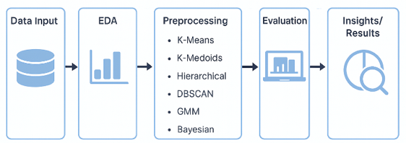
Methodology overview
Dataset Source: Mall Customer Segmentation (Kaggle)
Steps:
Exploratory Data Analysis (EDA)
Data Preprocessing (scaling, encoding)
Application of clustering algorithms
Evaluation using metrics such as Silhouette, Davies-Bouldin, and Calinski-Harabasz Scores.
.
Notes:
The project notebook outlines an end-to-end workflow that includes exploratory data analysis (EDA), preprocessing, encoding, and the application of six clustering algorithms: K-Means, K-Medoids (PAM), Agglomerative Hierarchical Clustering, DBSCAN, Gaussian Mixture Models (GMM), and Bayesian Clustering. Data preprocessing addressed missing values, scaled features with StandardScaler(), and encoded categorical attributes with LabelEncoder(). Visualizations illustrated the transformation of raw data into a standardized format, which enabled consistent comparison and interpretation of the clustering algorithms (Hastie, Tibshirani, & Friedman, 2009).
Clustering reveals hidden groupings in unlabeled data, offering insights for segmentation-based marketing. Each algorithm defines similarity and cluster boundaries differently. This study evaluates various algorithms based on performance, scalability, robustness, and interpretability to identify the best approach for mall customer segmentation (Irani, Pise, & Phatak, 2016; Mehta, Bawa, & Singh, 2020).

Slide 5
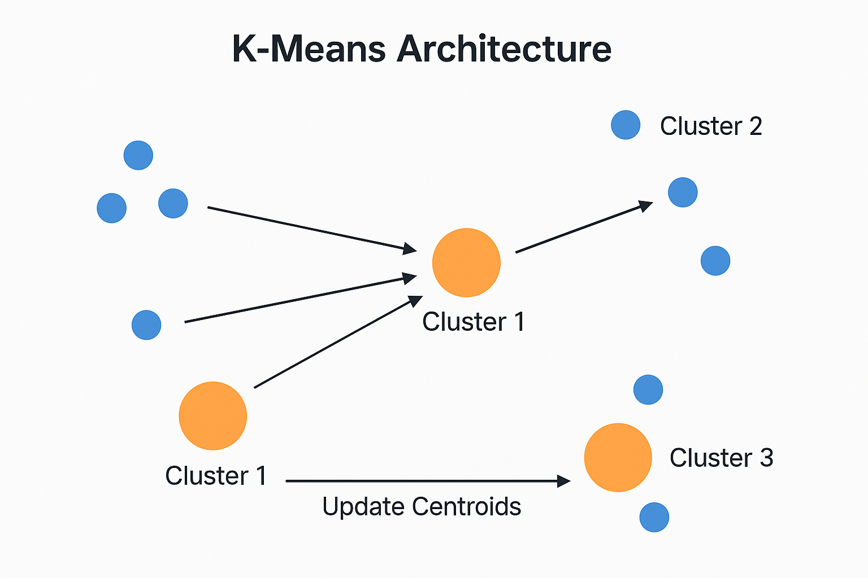
K-Means clustering
Partition-based algorithm minimizing within-cluster variance.
Optimal k = 5 (Elbow & Silhouette analysis).
Metrics: Silhouette = 0.272, DB = 1.181, CH = 62.13.
Revealed distinct cohorts: younger high-income spenders vs. older low-spending customers.
Efficient and interpretable but sensitive to initialization.
.
Notes:
K-Means is a clustering algorithm that partitions data into k clusters by minimizing within-cluster variance. It works iteratively by randomly initializing centroids, assigning points to the nearest centroid, and updating centroids until convergence. While efficient for large datasets and easy to interpret, K-Means is sensitive to initial centroid placement and assumes clusters are spherical and equally sized. Using the Elbow and Silhouette analyses, the optimal number of clusters was found to be five, with evaluation metrics of Silhouette = 0.272, Davies–Bouldin = 1.181, and Calinski–Harabasz = 62.13, indicating moderately compact and well-separated groupings. Cluster profiling further revealed interpretable, distinct customer cohorts: for example, one younger, high-income, high-spending segment (mean Age ≈ 28.7 years, Income ≈ $60.9 k, Spending Score ≈ 70), contrasted with an older, lower-spending group (mean Age ≈ 56.5 years, Income ≈ $46 k, Spending Score ≈ 39). These findings align with clustering theory that emphasizes high intra-similarity and low inter-similarity among groups (Irani et al., 2016).

Slide 6
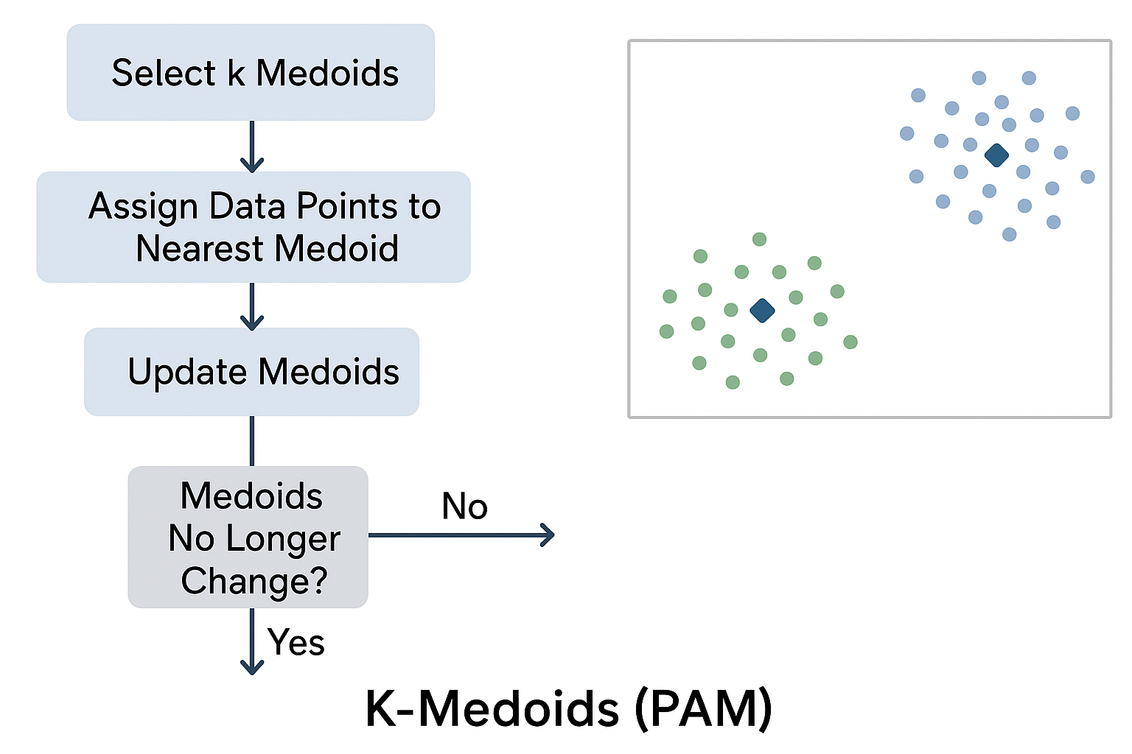
K-Medoids (PAM)
Uses actual data points as cluster centers for improved robustness.
Metrics: Silhouette = 0.243, DB = 1.385, CH = 49.94.
Identified younger high-spending and mid-aged low-spending cohorts.
Effective for small datasets, emphasizing interpretability and outlier resistance.
.
Notes:
Partitioning Around Medoids (PAM) is similar to K-Means but uses actual data points as cluster centers, enhancing robustness against outliers. Unlike K-Means, which minimizes squared distances, K-Medoids minimizes pairwise dissimilarities, typically measured via Manhattan or Euclidean distance. In the notebook implementation, PAM was applied with k = 5, producing an overall Silhouette = 0.243, Davies–Bouldin = 1.385, and Calinski–Harabasz = 49.94—slightly lower compactness than K-Means but improved stability in the presence of outliers. This method reflects the partition-based category of clustering algorithms discussed by Mehta, Bawa, and Singh (2020), emphasizing flexibility in distance measures and resilience to noisy data. Cluster profiling revealed several interpretable segments, including a younger, mid-income, high-spending cohort (mean Age ≈ 26.7 years, Income ≈ $49.8 k, Spending ≈ 68.5) and a moderate-age, high-income but low-spending group (mean Age ≈ 38.0 years, Income ≈ $89.1 k, Spending ≈ 23.7) . These distinctions confirm that PAM effectively captures realistic customer typologies using representative data points rather than computed centroids, making it particularly valuable for small to medium datasets where interpretability and robustness outweigh computational cost.

Slide 7
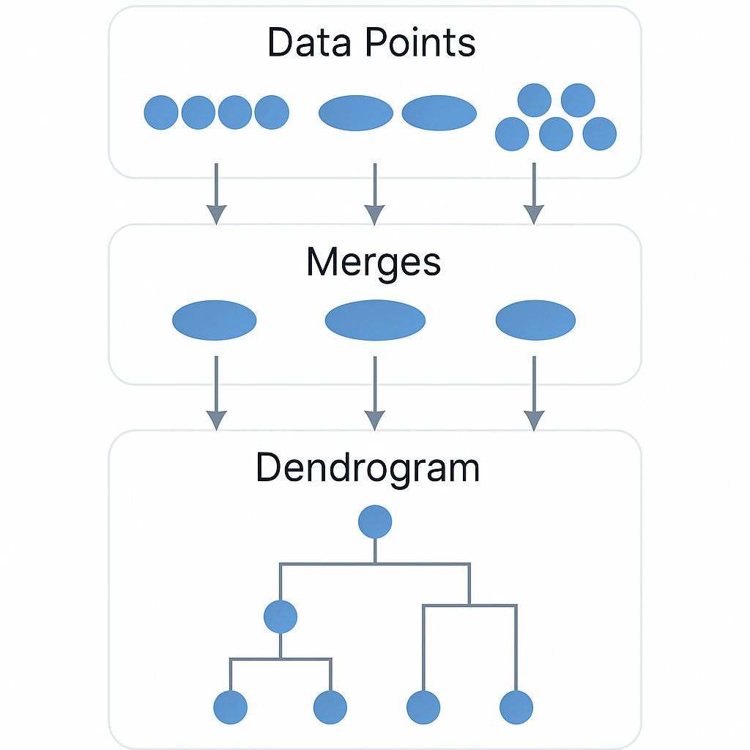
Agglomerative Hierarchical Clustering
Bottom-up clustering using Ward linkage.
Metrics: Silhouette = 0.287, DB = 1.220, CH = 64.47.
Revealed layered customer relationships through dendrogram visualization.
Computationally expensive but valuable for exploratory structure discovery.
.
Notes:
Agglomerative Hierarchical Clustering builds clusters in a bottom-up manner, starting with each data point as its own cluster and merging pairs based on linkage criteria—single, complete, or average linkage. In the notebook, the Ward linkage method was applied with k = 5, producing an interpretable dendrogram that clearly illustrated the stepwise merging process and revealed several natural customer groupings . Quantitatively, the model achieved a Silhouette = 0.287, Davies–Bouldin = 1.220, and Calinski–Harabasz = 64.47, indicating moderately cohesive and well-separated clusters with slightly better structure than K-Means and K-Medoids . The resulting cluster profiles highlighted distinct behavioral segments, including a young, high-income, high-spending group (mean Age ≈ 32.7 years, Income ≈ $86.5 k, Spending ≈ 82) and an older, moderate-income, low-spending group (mean Age ≈ 49.8 years, Income ≈ $44.1 k, Spending ≈ 39.7). The hierarchical approach is consistent with methods outlined by Irani et al. (2016) and Mehta et al. (2020), which emphasize the interpretability of dendrogram structures for exploratory data analysis. The dendrogram visualization effectively exposed hierarchical relationships across these cohorts, confirming the algorithm’s value for exploratory structure discovery, though its O(n²) computational cost and noise sensitivity make it less practical for very large datasets.

Slide 8
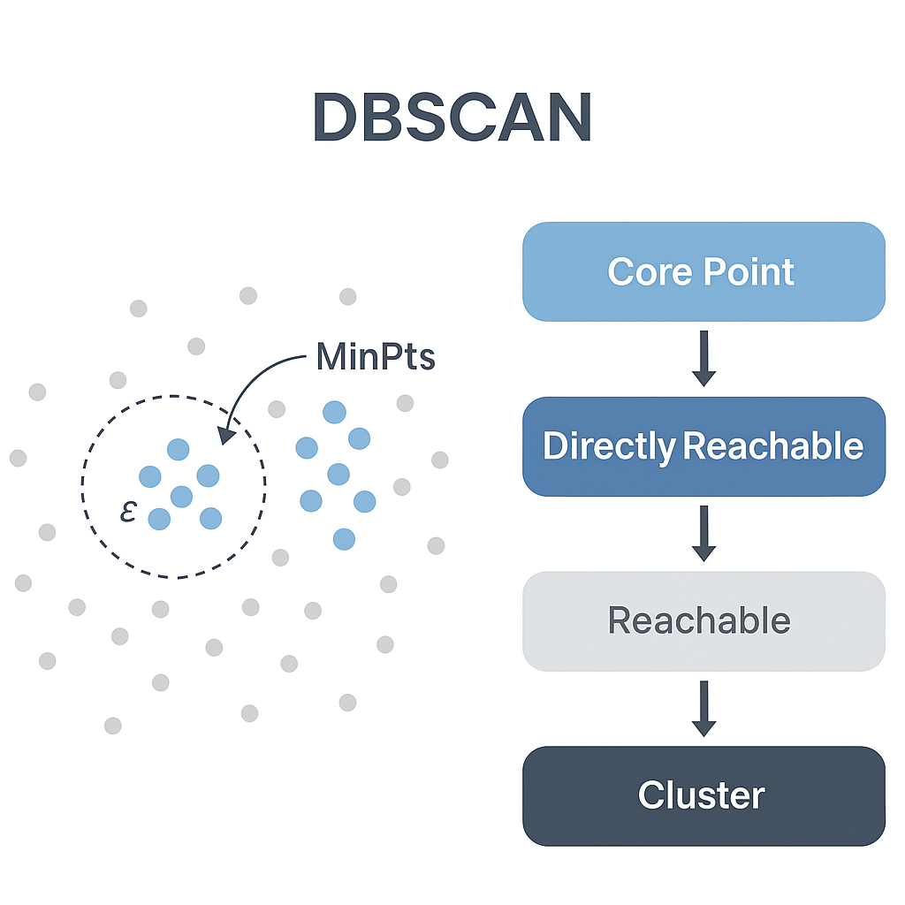
Density-Based Spatial Clustering of Applications w/ Noise (DBSCAN)
Density-based method identifying irregular cluster shapes and outliers.
Parameters: ε = 0.5, minPts = 5.
Formed 9 clusters + noise, isolating outlier customers.
Ideal for anomaly detection, though less effective in high-dimensional data.
.
Notes:
DBSCAN identifies clusters based on data density rather than distance. It defines clusters as regions of high point density separated by sparse areas. The algorithm depends on parameters epsilon (ε) and minimum samples (minPts), which were set to ε = 0.5 and min_samples = 5 in the notebook. Under these parameters, DBSCAN identified nine clusters (excluding noise), with one substantial noise group capturing outlier customers who did not belong to any dense region. Although internal metrics could not be computed due to the irregular cluster count and presence of noise, visualizations confirmed that DBSCAN successfully delineated non-spherical, unevenly distributed clusters while isolating outliers along sparse data regions.
The cluster profile summary showed that typical DBSCAN groupings corresponded to young, high-spending customers (mean Age ≈ 25 years, Spending ≈ 74–75) and older, moderate-income, average-spending customers (mean Age ≈ 49–57 years, Income ≈ $52–62 k, Spending ≈ 48–50) . As highlighted by Mehta et al. (2020), density-based algorithms like DBSCAN excel in detecting arbitrarily shaped clusters and filtering out outliers, a property that strengthens their utility for anomaly detection in customer analytics.

Slide 9
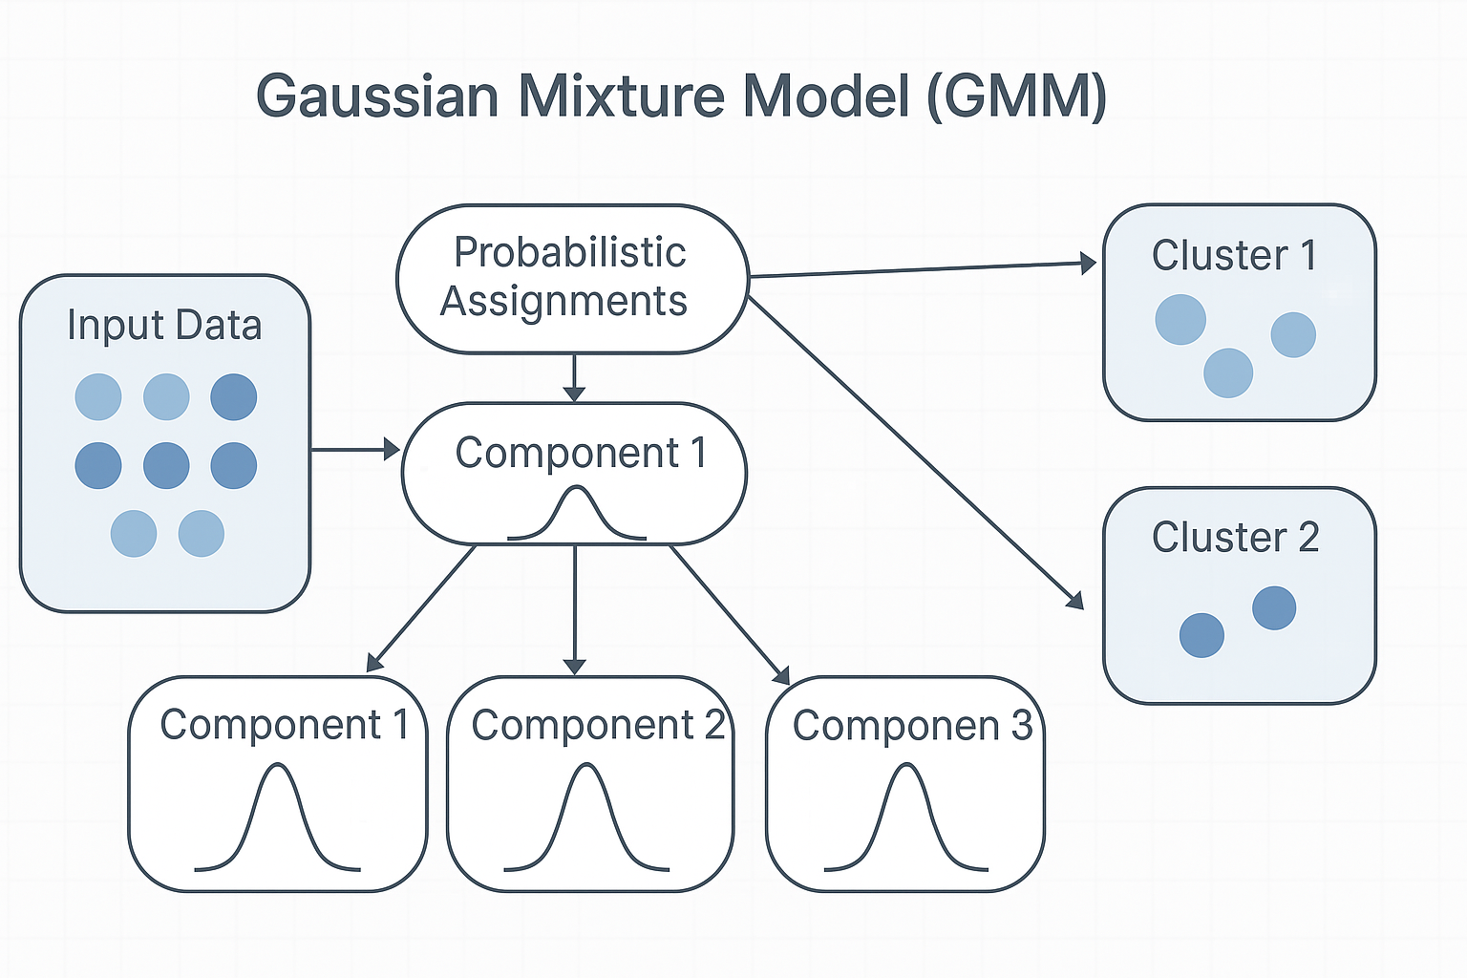
Gaussian Mixture Models (GMM)
Probabilistic approach modeling data as a mixture of Gaussian distributions.
Metrics: Silhouette = 0.222, DB = 1.211, CH = 45.82.
Allows overlapping clusters representing soft memberships.
Reflects real-world variability in customer behavior.
.
Notes:
GMM is a probabilistic model assuming data originates from a mixture of Gaussian distributions, where each cluster corresponds to a Gaussian component characterized by its mean and covariance matrix. Expectation-Maximization (EM) is used to iteratively estimate parameters until the model converges. In the notebook, a five-component GMM was applied, producing a Silhouette Score of 0.222, Davies–Bouldin Index of 1.211, and Calinski–Harabasz Score of 45.82, indicating moderately cohesive but flexible clusters with smooth transitions between groups. This result reflects the theoretical strengths of model-based clustering as described by Hastie, Tibshirani, and Friedman (2009), who emphasize mixture modeling for probabilistic segmentation. The probabilistic nature of GMM enabled overlapping boundaries between customer segments, reflecting real-world shopping behavior more effectively than hard-partitioning methods. Cluster profiling revealed distinct Gaussian-based groupings, such as a younger, high-income, high-spending cluster (mean Age ≈ 28 years, Income ≈ $62 k, Spending ≈ 72) and a mid-aged, moderate-income, low-spending group (mean Age ≈ 49 years, Income ≈ $44 k, Spending ≈ 56) . These soft, interpretable memberships illustrate GMM’s advantage in capturing nuanced spending patterns among mall customers, even when boundaries between behavioral groups are not sharply defined.

Slide 10
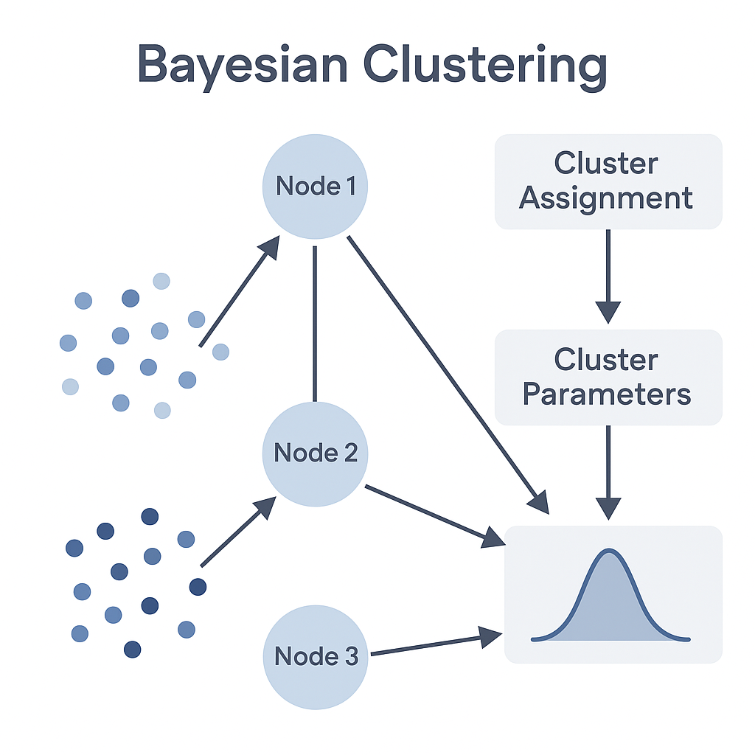
Bayesian Clustering
Bayesian Gaussian Mixture Model with Dirichlet priors.
Automatically determined ~9 effective clusters.
Metrics: Silhouette = 0.415, DB = 0.835, CH = 86.12.
Provided the most adaptive and interpretable results across all algorithms.
.
Notes:
Bayesian Clustering extends mixture modeling by integrating prior distributions to manage model complexity and uncertainty, automatically adjusting the number of clusters through the use of Dirichlet priors and Bayesian Information Criterion (BIC) for model selection. In the notebook, the Bayesian Gaussian Mixture Model (BGMM) was implemented with a maximum of 10 components, and the model inferred an optimal effective cluster count of approximately 9, reflecting its adaptive nature. The Bayesian model achieved the highest overall internal performance among all algorithms, with a Silhouette Score of 0.415, Davies–Bouldin Index of 0.835, and Calinski–Harabasz Score of 86.12, demonstrating superior cluster separation and compactness. These outcomes align with probabilistic principles outlined by Hastie et al. (2009) and ensemble insights from Zhou (2012), emphasizing adaptive modeling and balance between model simplicity and explanatory power.
Cluster profiling revealed interpretable and realistic consumer segments, including a younger, high-income, high-spending group (mean Age ≈ 32 years, Income ≈ $86 k, Spending ≈ 82) and an older, low-income, moderate-spending group (mean Age ≈ 55.9 years, Income ≈ $46 k, Spending ≈ 40) . These results highlight Bayesian Clustering’s strength in automatically inferring meaningful group structures with soft, probabilistic memberships—making it ideal for contexts where the number of customer segments is uncertain or when sample sizes are limited—although its computational demands and sensitivity to prior settings remain practical challenges.

Slide 11
Evaluation Metrics
Silhouette Score – measures cohesion and separation.
Davies–Bouldin Index – lower values indicate better clusters.
Calinski–Harabasz Score – higher values indicate stronger separation.
Bayesian GMM achieved the strongest clustering quality overall.
.
Notes:
Evaluating clustering quality requires internal validation metrics since ground truth labels are absent. This project applied three major indices: the Silhouette Score, Davies-Bouldin Index, and Calinski-Harabasz Score. The Silhouette Score measures cohesion and separation, with higher values indicating well-defined clusters. The Davies-Bouldin Index rewards smaller intra-cluster distances and larger inter-cluster distances, where lower scores denote better structure. The Calinski-Harabasz Score quantifies the variance ratio between clusters, favoring high separation. These metrics collectively enabled a quantitative comparison of clustering performance. K-Means and GMM exhibited strong performance consistency, while DBSCAN provided better handling of outliers.

Slide 12
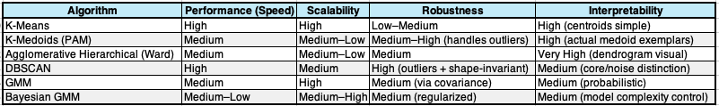
Comparative Analysis
Partitioning methods (K-Means, PAM): fast, interpretable, limited flexibility.
Hierarchical: reveals structure but computationally heavy.
DBSCAN: best for outlier detection.
GMM: models overlapping segments.
Bayesian: highest performance with adaptive complexity.
.
Notes:
The comparative findings across the six algorithms show trade-offs in efficiency, robustness, and interpretability. K-Means and K-Medoids are efficient and clear but struggle with irregular shapes. Hierarchical and density-based methods reveal complex structures but are computationally intensive. Model-based methods like GMM and Bayesian Clustering provide probabilistic interpretability, with Bayesian Clustering better at adapting complexity. These results align with the taxonomy of clustering approaches by Irani et al. (2016).The following table summarizes the comparative characteristics of each algorithm.

Slide 13
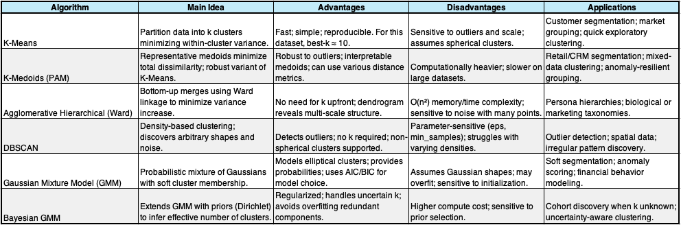
Key insights and reflection
Each clustering method has distinct strengths, with performance depending on dataset structure and business goals.
K-Means serves as a reliable baseline for segmentation, while PAM improves robustness against outliers.
DBSCAN excels at detecting anomalies and handling irregular data distributions.
GMM and Bayesian clustering provide advanced probabilistic insights with flexible, soft cluster memberships.
Hybrid approaches that blend deterministic and probabilistic models could enhance accuracy and adaptability (Hastie et al., 2009; Zhou, 2012).
Future directions: focus on anomaly detection, fraud prevention, predictive maintenance, and hybrid unsupervised–supervised segmentation pipelines.
.
Notes:
This research highlights that while all six clustering methods have unique strengths, their effectiveness is closely tied to dataset structure and goals. K-Means serves as a solid baseline for segmentation tasks, PAM is robust against outliers, and DBSCAN is effective for outlier detection in irregular distributions. GMM and Bayesian clustering offer advanced probabilistic insights with soft memberships. The findings showed Bayesian GMM had the highest structural integrity (Silhouette = 0.415). As suggested by Hastie et al. (2009) and Zhou (2012), hybrid frameworks that combine deterministic and probabilistic approaches might improve performance in the future. This study emphasizes the role of clustering in data-driven marketing decision-making and the need to choose suitable unsupervised learning models. Overall, this research underscores that unsupervised clustering techniques can effectively reveal meaningful customer segments for targeted marketing, aligning with Mehta et al. (2020) that suggests the choice of method is context dependent.
Future work could focus on anomaly and outlier detection, essential for fraud detection, predictive maintenance, and medical diagnostics. Transitioning from clustering to hybrid unsupervised-supervised pipelines promises enhanced customer segmentation and behavioral modeling applications

Slide 14
References
Irani, J., Pise, N., & Phatak, M. (2016). International Journal of Computer Applications.
Mehta, V., Bawa, S., & Singh, J. (2020). Artificial Intelligence Review.
Hastie, T., Tibshirani, R., & Friedman, J. (2009). The Elements of Statistical Learning.
Zhou, Z.-H. (2012). Ensemble Methods: Foundations and Algorithms.
Choudhary, V. J. (n.d.). Mall Customer Segmentation Data [Dataset]. Kaggle.
Notes:
To conduct this study on the analysis and assessment -----. Thank you so much for your time.

